Slide 1
Mathematics for Analytics and Finance
Sami Najafi
MSIS2402/2405
Module 7

Slide 2
Continuous Random Variables

Slide 3
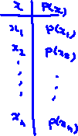
Continuous Random Variables
A continuous random variable is a variable that can assume any value on a continuum (that is, the set of possible values is continuous or “connected with no gaps”, i.e., each point is equal to the left and right limits to that point)
thickness of an item
time required to complete a task
temperature of a solution
height, in inches

Slide 4


Increasing The Number of Bins
Remark: As the number of bins increases, the probability associated with each bin decreases. Eventually, as the bins become extremely narrow, the probability of each individual bin approaches zero.

Slide 5

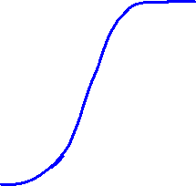
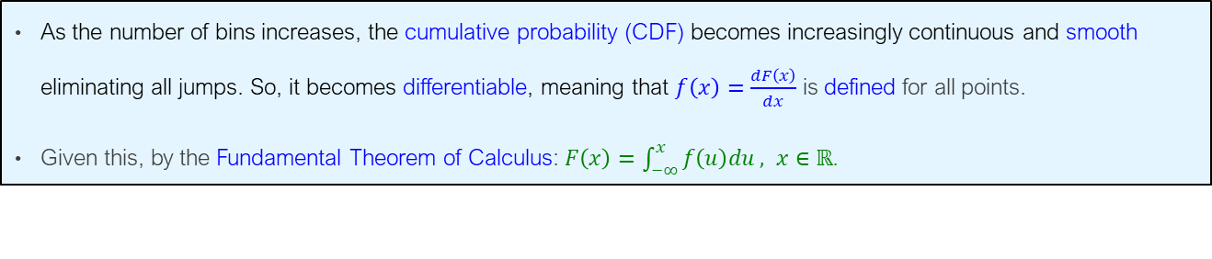


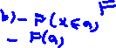
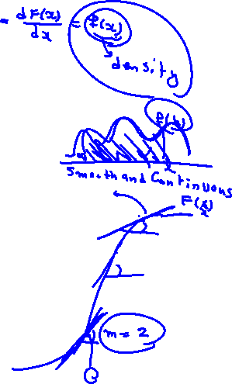
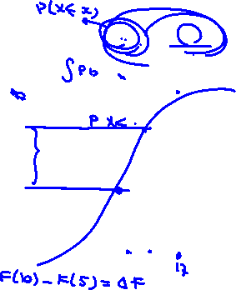
Increasing The Number of Bins
As the number of bins increases, the cumulative probability (CDF) becomes increasingly continuous and smooth eliminating all jumps. So, it becomes differentiable, meaning that $f\left(x\right)=\frac{dF\left(x\right)}{dx}$ is defined for all points.
Given this, by the Fundamental Theorem of Calculus: $F\left(x\right)=\int_{−∞}^{x}{f\left(u\right)du}, x∈\text{ℝ}$.

Slide 6
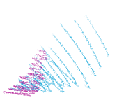
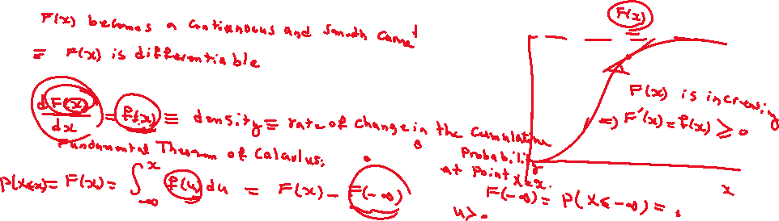
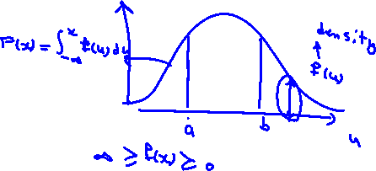

Slide 7

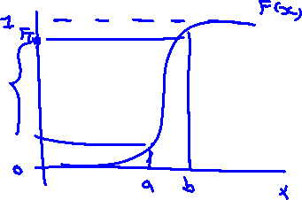
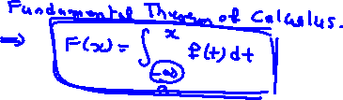


Slide 8
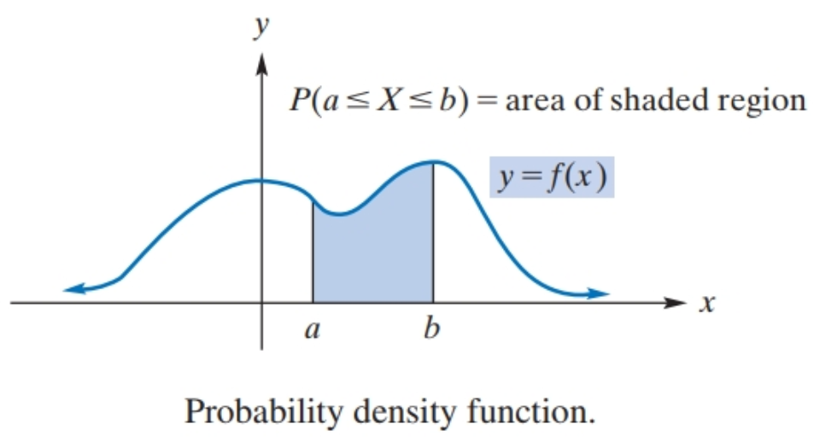
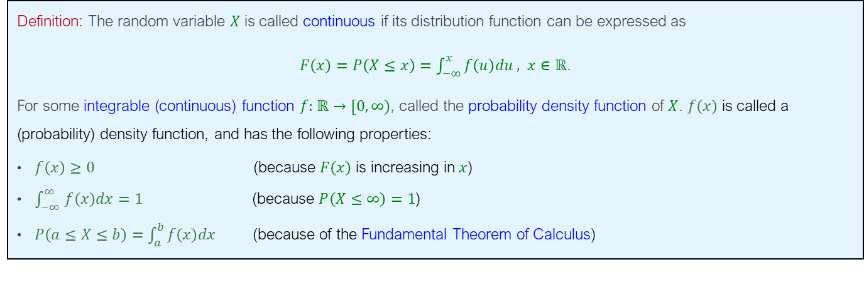
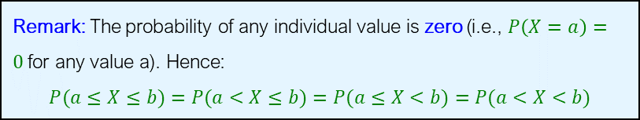
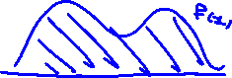

Continuous Random Variables
Definition: The random variable $X$ is called continuous if its distribution function can be expressed as
$F\left(x\right)=P\left(X≤x\right)=\int_{−∞}^{x}{f\left(u\right)du}, x∈\text{ℝ}$.
For some integrable (continuous) function $f:$ $\text{ℝ}→[0,∞)$, called the probability density function of $X$. $f\left(x\right)$is called a (probability) density function, and has the following properties:
$f\left(x\right)≥0$ (because $F\left(x\right)$ is increasing in $x$)
$\int_{−∞ }^{∞}{f\left(x\right)dx}=1$ (because $P\left(X≤∞\right)=1$)
$P\left(a≤X≤b\right)=\int_{a }^{b}{f\left(x\right)dx}$ (because of the Fundamental Theorem of Calculus)
Remark: The probability of any individual value is zero (i.e., $P\left(X=a\right)=0$for any value a). Hence:
$$P(a≤X≤b)=P(a<X≤b)=P(a≤X<b)=P(a<X<b)$$

Slide 9
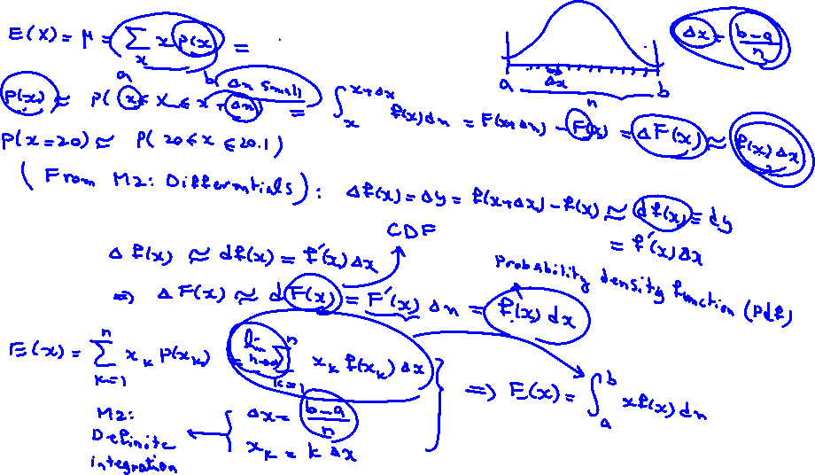

Slide 10
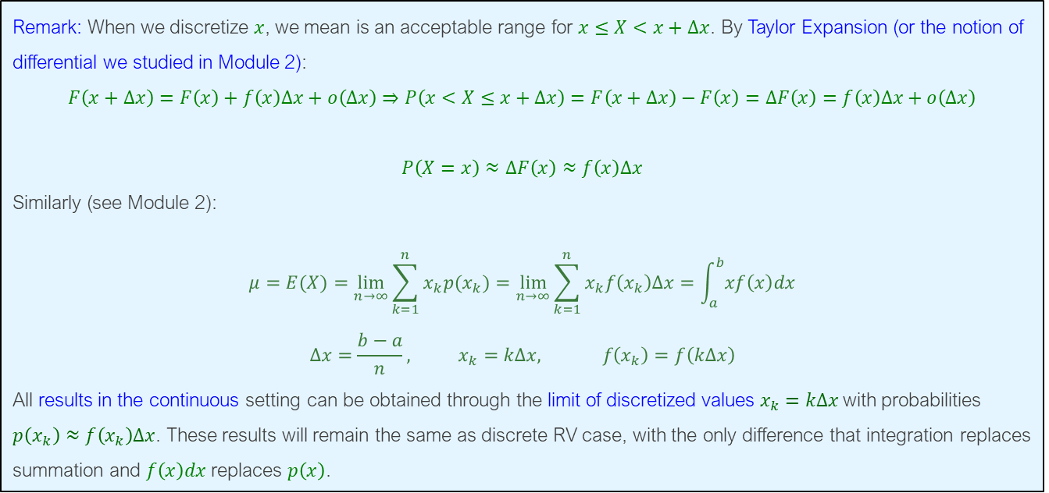
Continuous Random Variables
Remark: When we discretize $x$, we mean is an acceptable range for $x≤X<x+Δx$. By Taylor Expansion (or the notion of differential we studied in Module 2):
$$F\left(x+Δx\right)=F\left(x\right)+f\left(x\right)Δx+o\left(Δx\right)⇒P\left(x<X≤x+Δx\right)=F\left(x+Δx\right)−F\left(x\right)=ΔF\left(x\right)=f\left(x\right)Δx+o\left(Δx\right)$$
$$P\left(X=x\right)≈ΔF\left(x\right)≈f\left(x\right)Δx$$
Similarly (see Module 2):
$$μ=E(X)=\lim_{n→∞}{\sum_{k=1}^{n}{x_{k}p(x_{k})}}=\lim_{n→∞}{\sum_{k=1}^{n}{x_{k}f\left(x_{k}\right)Δx}}=\int_{a}^{b}{xf\left(x\right)dx}$$
$$Δx=\frac{b−a}{n}, x_{k}=kΔx, f\left(x_{k}\right)=f\left(kΔx\right)$$
All results in the continuous setting can be obtained through the limit of discretized values $x_{k}=kΔx$with probabilities $p\left(x_{k}\right)≈f\left(x_{k}\right)Δx$. These results will remain the same as discrete RV case, with the only difference that integration replaces summation and $f\left(x\right)dx$ replaces $p\left(x\right)$.

Slide 11
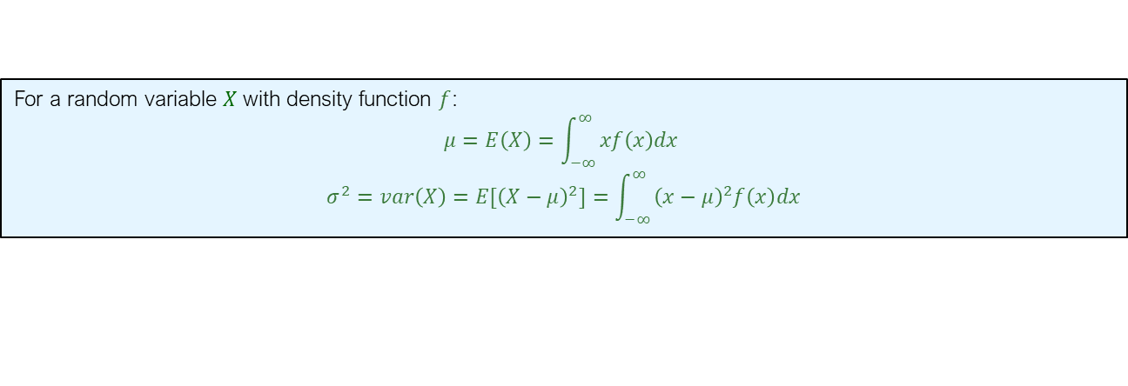


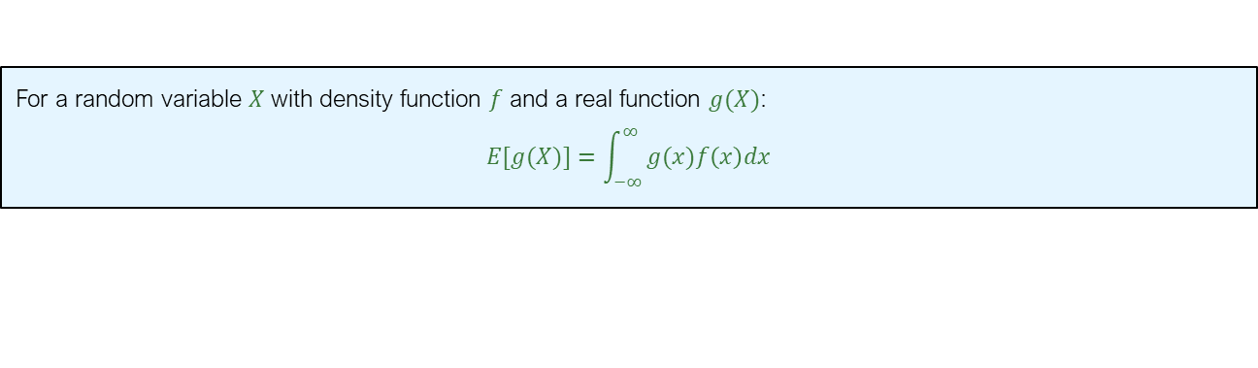
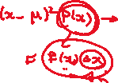


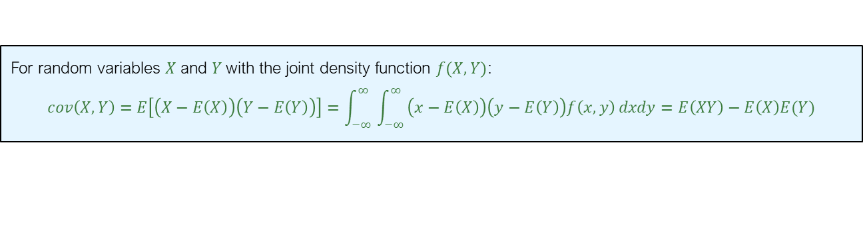
Summary of Some Properties
For a random variable $X$ with density function $f$:
$$μ=E\left(X\right)=\int_{−∞ }^{∞}{xf\left(x\right)dx}$$
$$σ^{2}=var\left(X\right)=E{[\left(X−μ\right)}^{2}]=\int_{−∞ }^{∞}{{\left(x−μ\right)}^{2}f\left(x\right)dx}$$
For a random variable $X$ with density function $f$ and a real function $g(X)$:
$$E[g(X)]=\int_{−∞ }^{∞}{g(x)f\left(x\right)dx}$$
For random variables $X$ and $Y$with the joint density function $f(X,Y)$:
$$cov\left(X,Y\right)=E\left[\left(X−E\left(X\right)\right)\left(Y−E\left(Y\right)\right)\right]=\int_{−∞ }^{∞}{\int_{−∞ }^{∞}{\left(x−E\left(X\right)\right)\left(y−E\left(Y\right)\right)f\left(x,y\right)}dxdy}=E\left(XY\right)−E\left(X\right)E(Y)$$
Two random variables $X$ and $Y$with the joint density function $f(X,Y)$ are independent if and only if
$f\left(a,b\right)=f_{X}\left(a\right)f_{Y}(b)$ for all $a,b∈\text{ℝ}$

Slide 12

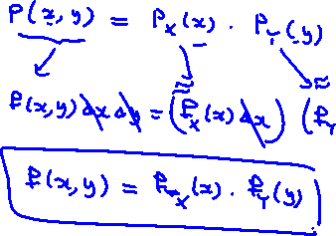


Slide 13
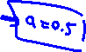
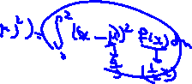

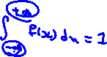
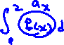
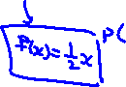
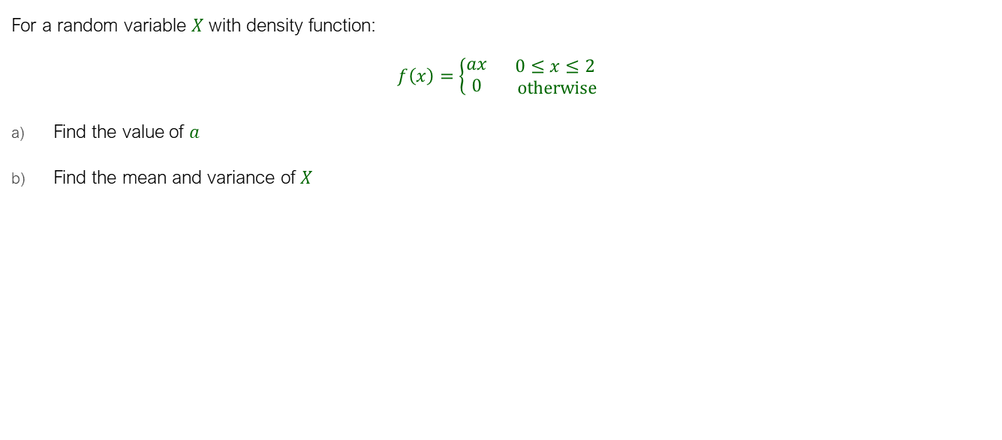
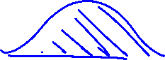



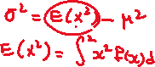

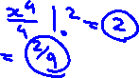
Example
For a random variable $X$ with density function:
$$f\left(x\right)=\left\{\begin{aligned}ax \\ 0\end{aligned}\right. \begin{aligned}0≤x≤2 \\ otherwise\end{aligned}$$
Find the value of $a$
Find the mean and variance of $X$

Slide 14
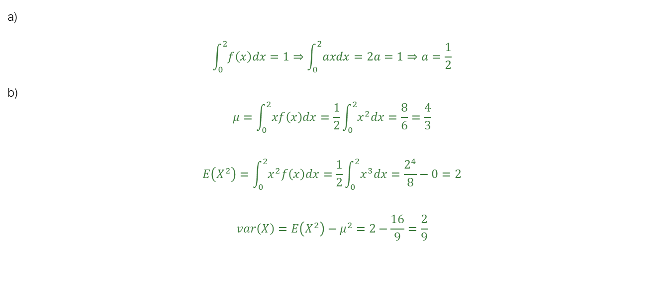
Solution
a)
$$\int_{0 }^{2}{f\left(x\right)dx}=1⇒\int_{0 }^{2}{axdx=2a=1}⇒a=\frac{1}{2}$$
b)
$$μ=\int_{0 }^{2}{xf\left(x\right)dx}=\frac{1}{2}\int_{0 }^{2}{x^{2}dx}=\frac{8}{6}=\frac{4}{3}$$
$$E\left(X^{2}\right)=\int_{0 }^{2}{x^{2}f\left(x\right)dx}=\frac{1}{2}\int_{0 }^{2}{x^{3}dx}=\frac{2^{4}}{8}−0=2$$
$$var\left(X\right)=E\left(X^{2}\right)−μ^{2}=2−\frac{16}{9}=\frac{2}{9}$$

Slide 15
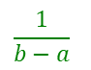
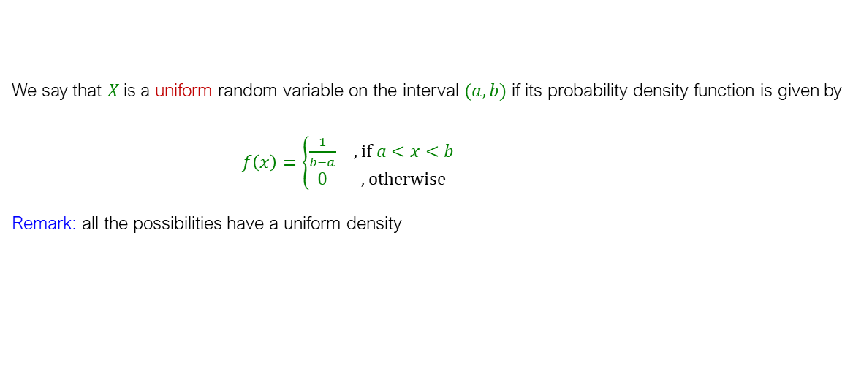



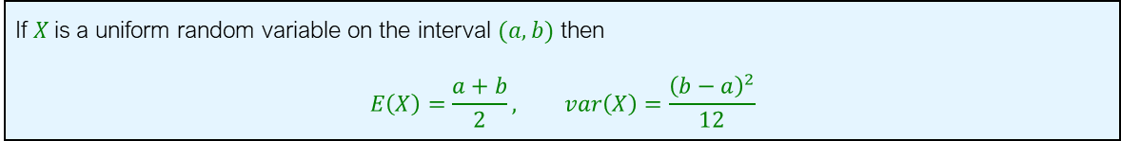
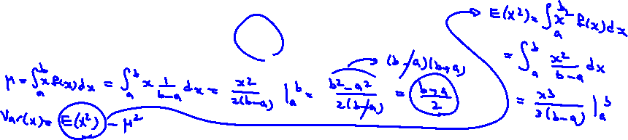
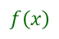

The Uniform Distribution
We say that $X$is a uniform random variable on the interval $(a,b)$ if its probability density function is given by
$f\left(x\right)=\left\{\begin{matrix}\frac{1}{b−a} & , if a<x<b \\ 0 & , otherwise\end{matrix}\right.$
Remark: all the possibilities have a uniform density
$$f\left(x\right)$$
$$\frac{1}{b−a}$$
$$a$$
$$b$$
$$x$$
If $X$is a uniform random variable on the interval $(a,b)$ then
$$E\left(X\right)=\frac{a+b}{2}, var\left(X\right)=\frac{{\left(b−a\right)}^{2}}{12}$$

Slide 16
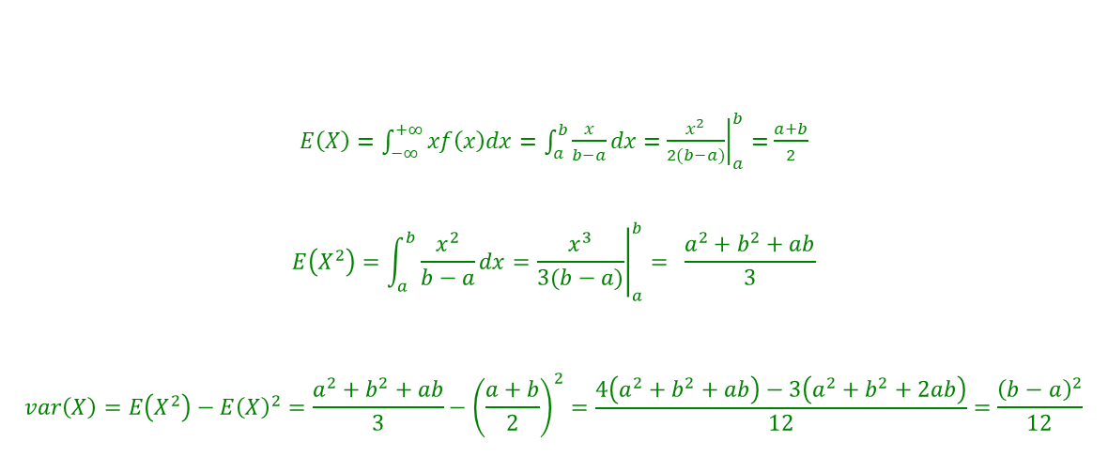
The Uniform Mean and Variance
$E\left(X\right)=\int_{−∞}^{+∞}{xf\left(x\right)dx}=\int_{a}^{b}{\frac{x}{b−a}dx}=$ ${\left.\frac{x^{2}}{2(b−a)}\right|}_{a}^{b}=$ $\frac{a+b}{2}$
$$E\left(X^{2}\right)=\int_{a}^{b}{\frac{x^{2}}{b−a}dx}={\left.\frac{x^{3}}{3(b−a)}\right|}_{a}^{b}= \frac{a^{2}+b^{2}+ab}{3}$$
$$var\left(X\right)=E\left(X^{2}\right)−E{\left(X\right)}^{2}=\frac{a^{2}+b^{2}+ab}{3}−{\left(\frac{a+b}{2}\right)}^{2}=\frac{4\left(a^{2}+b^{2}+ab\right)−3\left(a^{2}+b^{2}+2ab\right)}{12}=\frac{{\left(b−a\right)}^{2}}{12}$$

Slide 17

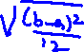
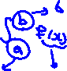

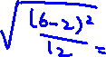
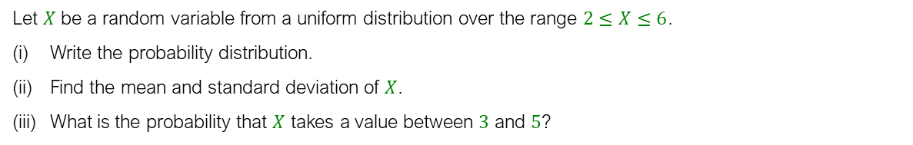


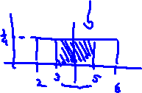
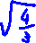
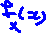
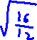
Example
Let $X$ be a random variable from a uniform distribution over the range $2≤X≤6$.
Write the probability distribution.
Find the mean and standard deviation of $X$.
What is the probability that $X$ takes a value between $3$ and $5$?

Slide 18
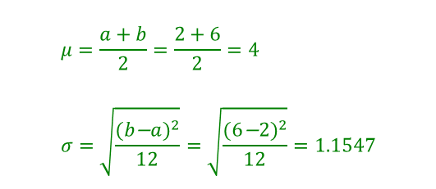

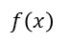
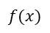
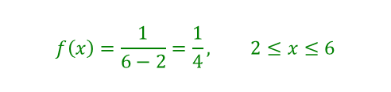
Solution
$$f\left(x\right)=\frac{1}{6−2}=\frac{1}{4}, 2≤x≤6$$
$$μ=\frac{a+b}{2}=\frac{2+6}{2}=4 \\ σ=\sqrt{\frac{(b\text{−}a)^{2}}{12}}=\sqrt{\frac{(6\text{−}2)^{2}}{12}}=1.1547$$
$$P\left(3≤X≤5\right)=\frac{5−3}{6−2}=0.5$$
$$f\left(x\right)$$
0.25
2
3
4
5
6
$$f(x)$$

Slide 19








Slide 20
The Exponential Distribution
Often used to model the length of time between the occurrence of two successive events (the interarrival times)
Examples:
Time between two successive trucks arriving at an unloading dock
Time between two successive transactions at an ATM Machine
Time between two successive phone calls to the main operator
Note: in many cases, service times and waiting times are exponentially distributed.

Slide 21



Exponential Distribution
A random variable $T$ is an exponential random variable with parameter $λ$, for some $λ>0$:
$$f_{T}\left(t\right)=\left\{\begin{matrix}λe^{−λt} & , if t≥0 \\ 0 & ,if t<0\end{matrix}\right.$$
where:
$λ$: the average number of events in a unit of the interval (the rate of occurrence of the events)
$t$: the interval of time or space over which events occur (e.g., a specific time duration, area, or volume)

Slide 22





The Exponential Distribution
Remark: The CDF of an exponential random variable is:
$$F_{T}\left(t\right)=P(T≤t)=\int_{0}^{t}{λe^{−λx}dx}=1−e^{−λt}$$
In R: $F_{T}\left(t\right)=pexp(t,λ)$
Remark: If $X$is an exponential random variable with parameter $λ$ then its mean and variance are:
$$E\left(T\right)=\frac{1}{λ}, var\left(T\right)=\frac{1}{λ^{2}}$$

Slide 23


Example
Customers arrive at the service counter at the rate of $15$ per hour. What is the probability that the inter-arrival time between two customers is less than three minutes?

Slide 24

Solution
$$\left.\begin{aligned}&λ=15\text{/}\text{hr} \\ &t=\frac{1}{20}hr\end{aligned}\right\}⇒λt=\frac{15}{20}=0.75$$
$$P\left(T<\frac{1}{20}\right)=1−e^{−λt}=1−e^{−0.75}=0.5276$$
= pexp(0.05,15)

Slide 25







Example
A company that receives most of its orders by telephone conducted a study to determine how long customers were willing to wait on hold before ordering a product. The length of waiting time was found to be a variable best approximated by an exponential distribution with a mean waiting time of $3$ minutes. What proportion of customers having to wait more than $4.5$ minutes before placing an order?

Slide 26

Solution
$$λ=\frac{1}{E(T)}=\frac{1}{3}\text{/} \text{min} \\ t=4.5 \text{min} \\ P\left(T≥t\right)=e^{−λ\text{t}}=e^{−\frac{4.5}{3}}=e^{−1.5}=0.2231$$

Slide 27









The Normal Distribution
Most important distribution in statistics (also called “Gaussian”)
Often occurs, e.g., heights, IQ, returns, errors
Used to approximate others (even discrete), e.g., Binomial
Useful in problems involving large amount of data
Bell Shaped
Symmetric
Mean = Median = Mode
Location is determined by the mean, $μ$
Spread is determined by the standard deviation, $σ$
The random variable has an infinite range: $−∞$ to $+∞$
We use the notation: $N(μ,σ)$
$$f(x)$$
$$σ$$
$$x$$
$$μ$$

Slide 28




The Normal Distribution
We say that $X$is a normal random variable (or simply that $X$ is normally distributed) with parameters $μ$ and $σ$ if the density of $X$ is given by
$$f\left(x\right)=\frac{1}{σ\sqrt{2π}}e^{−\frac{1}{2}{\left(\frac{x−μ}{σ}\right)}^{2}}, −∞<x<+∞$$
where:
$e=$ Euler’s value $≈2.718, π=$Pi value $≈3.14159$
$$f(x)$$
$$σ$$
$$x$$
$$μ$$
Remark: If $X$is a normal random variable with parameters $μ$ and $σ$ then its mean and variance are:
$$E\left(X\right)=μ, var\left(X\right)=σ^{2}$$

Slide 29



Properties of the Normal Distribution
In a normal distribution:
Approximately $68\%$ of all possible values lie within one standard deviation ($σ$) from the mean ($μ$).
Roughly $95\%$ of all possible values fall within two standard deviations ($2σ$) from the mean.
Almost $99.7\%$ of all possible values are encompassed within three standard deviations ($3σ$) from the mean.

Slide 30







The Standard Normal Distribution
Standard Normal Distribution: Also known as: “$Z$” distribution
Mean: $μ=0$
Standard Deviation: $σ=1$
Key observations:
Values above the mean → Positive Z-values
Values below the mean have → Negative Z-values
$$f(z)$$
$$σ=1$$
$$z$$
$$μ=0$$

Slide 31



Slide 32

Standardizing Process for a Normal Distribution
Any normal distribution (with any mean and standard deviation) can be transformed into the standard normal distribution (Z) (Standardization)
Standardization is often used an alternative approach for computing normal probabilities.
Translate from any point $x$ on the original normal distribution to the corresponding point $z$(or $z_{x}$) on the standard normal distribution by subtracting the mean of $X$ and dividing by its standard deviation:
$${z≡z}_{x}=\frac{x−μ}{σ}$$
What does Z-value tell us?

Slide 33











Example
If $X$ is distributed normally with mean of $100$ and standard deviation of $50$, find the $z$ value for $x=200$.

Slide 34




Solution
If $X$ is distributed normally with mean of $100$ and standard deviation of $50$, the $z$ value for $x=200$ is
$$z_{200}=\frac{x−μ}{σ}=\frac{200−100}{50}=2$$
This says that $=200$ is two standard deviations ($2$ increments of $50$ units) above the mean of $100$.
$$100$$
$$200$$
X
(μ = 100, σ = 50)
0
2.0
Z
(μ = 0, σ = 1)
Remark: Converting to $z$ does not change the probabilities.
$$P\left(X≤x\right)=P\left(\frac{X−μ}{σ}≤\frac{x−μ}{σ}\right)=P\left(Z≤\frac{x−μ}{σ}\right)=P\left(Z≤z_{x}\right)$$

Slide 35



Normal Probabilities in R
$α=P\left(X≤x\right)=$ pnorm(x,μ,σ,1)
Or:
$α=P\left(Z≤z\right)=$ pnorm(z)
$$α$$
$$x=\text{q}\text{norm}\left(α,μ\text{,}\text{s}\right)$$
$$z_{x}=\text{q}\text{norm}(α)$$
x
μ
X
z
0
Z
Example: $P\left(Z≤0.12\right)=pnorm\left(0.12\right)=0.5478$

Slide 36





Normal Distribution in Table
Finding Standard Normal Probabilities: Table Z
$z$-table: The value in the table indicates the probability $P\left(Z≤z\right)$for a specified value of $z$, like $z=0.12$.
The column gives the second decimal value of $z$
The row gives the value of $z$ up to the first decimal point
Example: $P\left(Z≤0.12\right)=0.5478$
8
8.6
X
0
0.12
Z

Slide 37




Example
Let $X$ be the time to download a movie from the internet. Suppose $X$ is normal with mean $8$ minutes and standard deviation $5$ minutes. Find $P(X<8.6)$.

Slide 38

Solution
8
8.6
X
0
0.12
Z
$$z_{8.6}=\frac{x−μ}{σ}=\frac{8.6−8}{5}=0.12 \\ P\left(X<8.6\right)=P\left(Z<0.12\right)=pnorm\left(0.12\right)=0.5478$$

Slide 39




Example
At a bank, not all customers experience the same waiting time in line. Assuming the waiting times are normally distributed with an average of $6$ minutes and a standard deviation of $2$ minutes, what is the probability that a customer will wait more than $10$ minutes?

Slide 40

Solution
6
10
X
0
2
Z
$$z_{10}=\frac{10−6}{2}=2 \\ P\left(X>10\right)=P\left(Z>2\right)=1−pnorm\left(2\right)=0.023$$

Slide 41







Example
Last year's customer satisfaction scores for a product followed a normal distribution with an average score of $72$ and a standard deviation of $12$. Out of $500$ customers surveyed, how many, on average, gave satisfaction scores higher than $78$?

Slide 42


Solution
$$z_{78}=\frac{78−72}{12}=0.5 \\ P\left(X>78\right)= \text{P}\left(Z>0.5\right)=1−pnorm(0.5) =0.31$$
Number of customers: $Y\sim Binomial(500,0.31)$ $$E\left(Y\right)=500× 0.31=155$$
72
78
X
0
1
Z

Slide 43








Example:
Let $X$ be the time to download a movie from the internet. Suppose $X$ is normal with mean $8$ minutes and standard deviation $5$ minutes. Find $P(8<X<8.6)$.

Slide 44


Example:
$$z_{8.6}=\frac{8.6−8}{5}=0.12 \\ z_{8}=\frac{8−8}{5}=0$$
8
8.6
X
0
0.12
Z
$$P\left(8<X<8.6\right)=P\left(0<Z<0.12\right)=P(Z≤0.12) −P(Z<0)$$
$$=pnorm(0.12)\text{−}pnorm(0)=0.047$$

Slide 45







Given a Normal Probability Find the $x$ Value
Steps to find the $x$ value for a known probability $α$ :
1. Find $z_{x}$ for the known cumulative probability $α$:
$$z_{x}=qnorm(α)$$
2. Convert to $x$ by using the formula:
$$x=μ+z_{x}σ$$
$$α$$
x
μ
X
z_{x}
0
Z
$$z_{x}=qnorm(α)$$

Slide 46



Example
Last year's customer satisfaction scores for a product followed a normal distribution with an average score of $72$ and a standard deviation of $12$. What is the ${90}^{th}$ percentile of our customer satisfaction scores?

Slide 47


Solution
$$z_{x}=qnorm(0.9) =1.28 \\ x=μ+z_{x}σ=72+1.28×12=87.36$$
72
x = ?
X
0
z
Z

Slide 48






Solution by Using Table
We can also use table to find z
Second decimal: 0.08
First decimal: 1.20

